Slide 1
AITrain
AI for Environmental
Sustainability in Agriculture
Soil, water and resource decisions supported by data
Assoc. Prof. Dr. Vlad Stoian
AITrain Erasmus+ project
AITrain
01
Notes:
Explain ai for environmental
sustainability in agriculture. Soil, water and resource decisions supported by data Assoc. Prof. Dr. Vlad Stoian AITrain Erasmus+ project Ask learners to connect the information with a concrete decision in their field of study.

Slide 2
Learning outcomes
Explain interactions between farming and natural resources.
Describe AI, IoT and remote-sensing applications.
Identify measurements for environmental assessment.
Compare management options using explicit indicators.
AITrain
02
Notes:
Explain learning outcomes. Explain interactions between farming and natural resources. Describe AI, IoT and remote-sensing applications. Identify measurements for environmental assessment. Compare management options using explicit indicators. Ask learners to connect the information with a concrete decision in their field of study.

Slide 3
Agriculture and environmental processes
Crop growth depends on soil, water and climate.
Management changes nutrient and water flows.
Farm operations use energy and other resources.
Environmental assessment examines the effects of those choices.
AITrain
03
Notes:
Explain agriculture and environmental processes. Crop growth depends on soil, water and climate. Management changes nutrient and water flows. Farm operations use energy and other resources. Environmental assessment examines the effects of those choices. Ask learners to connect the information with a concrete decision in their field of study.

Slide 4
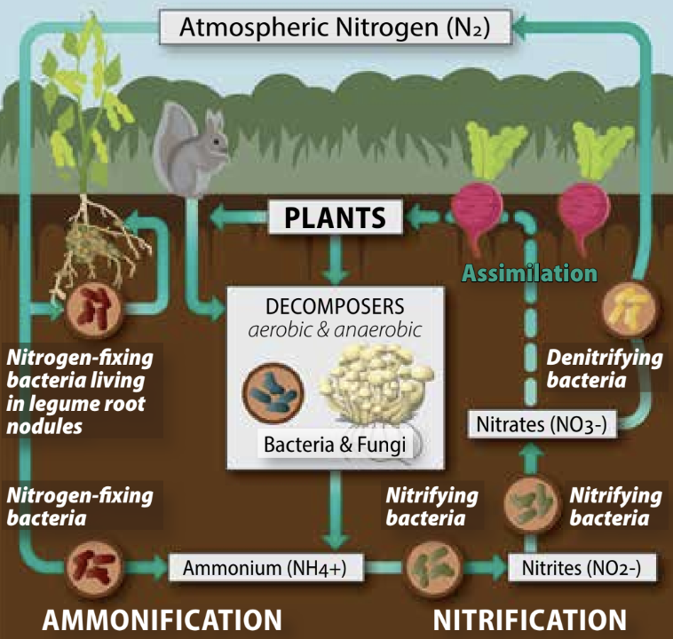
Soil as a living system
Roots, microorganisms and soil fauna interact.
Organic matter contributes to soil functions.
Structure influences air and water movement.
Soil health requires biological and physical interpretation.
AITrain
04
Notes:
Explain soil as a living system. Roots, microorganisms and soil fauna interact. Organic matter contributes to soil functions. Structure influences air and water movement. Soil health requires biological and physical interpretation. Ask learners to connect the information with a concrete decision in their field of study.
Image credit: SARE, Our Living Soil. https://www.sare.org/publications/farming-with-soil-life/our-living-soil/

Slide 5
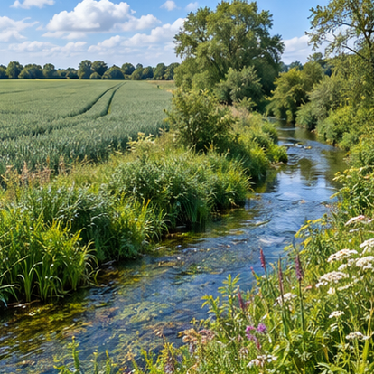
Nutrient movement and water quality
Applied nutrients can follow several pathways.
Crop uptake depends on demand and availability.
Runoff and drainage can transport nutrients away.
Management needs information about soil, timing and water flow.
AI-generated illustration
AITrain
05
Notes:
Explain nutrient movement and water quality. Applied nutrients can follow several pathways. Crop uptake depends on demand and availability. Runoff and drainage can transport nutrients away. Management needs information about soil, timing and water flow. Ask learners to connect the information with a concrete decision in their field of study.
Image: AI-generated illustrative scene. It represents the subject conceptually and does not document a specific farm, animal, product or measured result.

Slide 6
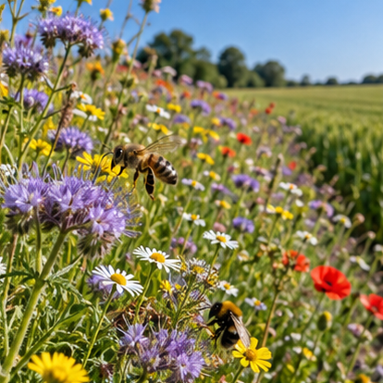
Biodiversity and farming systems
Crop diversity changes the production environment.
Habitats support organisms within the agricultural landscape.
Monitoring can reveal spatial and seasonal differences.
Management should consider production and ecological effects.
AI-generated illustration
AITrain
06
Notes:
Explain biodiversity and farming systems. Crop diversity changes the production environment. Habitats support organisms within the agricultural landscape. Monitoring can reveal spatial and seasonal differences. Management should consider production and ecological effects. Ask learners to connect the information with a concrete decision in their field of study.
Image: AI-generated illustrative scene. It represents the subject conceptually and does not document a specific farm, animal, product or measured result.

Slide 7
AI tasks in environmental management
Classification identifies categories in images or records.
Prediction estimates future conditions or responses.
Anomaly detection highlights unexpected measurements.
Decision support compares options using stated objectives.
AITrain
07
Notes:
Explain ai tasks in environmental management. Classification identifies categories in images or records. Prediction estimates future conditions or responses. Anomaly detection highlights unexpected measurements. Decision support compares options using stated objectives. Ask learners to connect the information with a concrete decision in their field of study.

Slide 8
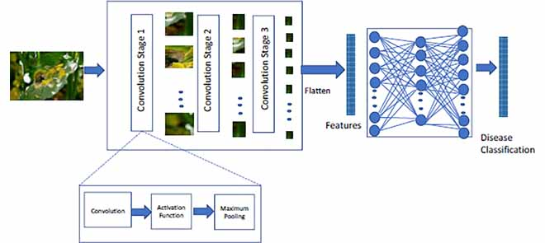
Machine learning and model training
Training examples connect inputs with reference outcomes.
A model learns relationships within those examples.
Independent observations test performance on new cases.
Local conditions affect how well the model transfers.
AITrain
08
Notes:
Explain machine learning and model training. Training examples connect inputs with reference outcomes. A model learns relationships within those examples. Independent observations test performance on new cases. Local conditions affect how well the model transfers. Ask learners to connect the information with a concrete decision in their field of study.

Slide 9
Generative and predictive AI
Generative tools produce text or other content.
Predictive tools estimate values or event probabilities.
Each tool needs a task-appropriate verification method.
Agricultural decisions need traceable evidence and domain knowledge.
AITrain
09
Notes:
Explain generative and predictive ai. Generative tools produce text or other content. Predictive tools estimate values or event probabilities. Each tool needs a task-appropriate verification method. Agricultural decisions need traceable evidence and domain knowledge. Ask learners to connect the information with a concrete decision in their field of study.

Slide 10
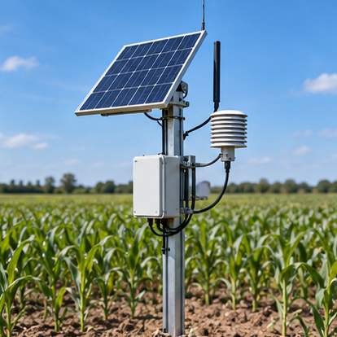
IoT, cloud and edge processing
Connected devices collect observations in the field.
Gateways move records between sensors and platforms.
Cloud systems combine information from many locations.
Edge processing analyses data near the measuring device.
AI-generated illustration
AITrain
10
Notes:
Explain iot, cloud and edge processing. Connected devices collect observations in the field. Gateways move records between sensors and platforms. Cloud systems combine information from many locations. Edge processing analyses data near the measuring device. Ask learners to connect the information with a concrete decision in their field of study.
Image: AI-generated illustrative scene. It represents the subject conceptually and does not document a specific farm, animal, product or measured result.

Slide 11
Environmental data sources
Soil sampling supplies physical and chemical information.
Weather stations describe local atmospheric conditions.
Satellites and drones provide spatial observations.
Machinery records connect operations with resource use.
AITrain
11
Notes:
Explain environmental data sources. Soil sampling supplies physical and chemical information. Weather stations describe local atmospheric conditions. Satellites and drones provide spatial observations. Machinery records connect operations with resource use. Ask learners to connect the information with a concrete decision in their field of study.

Slide 12
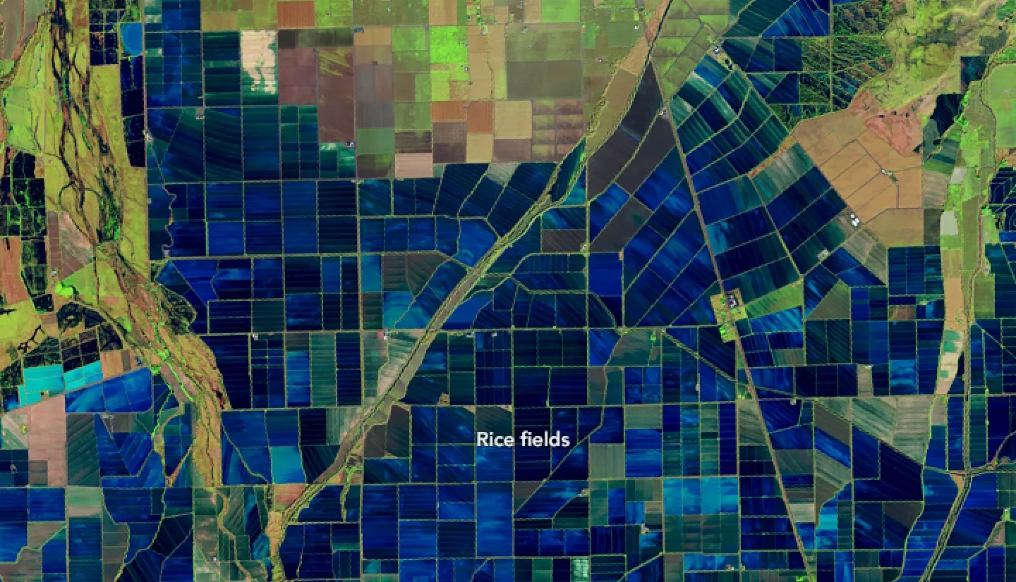
Remote sensing and spatial interpretation
Spectral measurements describe surface reflectance.
Time series reveal changes during the growing season.
Spatial patterns help locate areas for inspection.
Ground observations support interpretation of image features.
AITrain
12
Notes:
Explain remote sensing and spatial interpretation. Spectral measurements describe surface reflectance. Time series reveal changes during the growing season. Spatial patterns help locate areas for inspection. Ground observations support interpretation of image features. Ask learners to connect the information with a concrete decision in their field of study.
Image credit: NASA Applied Sciences, satellite remote sensing for agriculture. https://appliedsciences.nasa.gov/what-we-do/food-security-agriculture/inside-food-security-agriculture

Slide 13
Data quality and measurement scale
Sensor position influences what a reading represents.
Calibration and maintenance affect measurement reliability.
Different spatial resolutions can hide local differences.
Time alignment matters when combining several data sources.
AITrain
13
Notes:
Explain data quality and measurement scale. Sensor position influences what a reading represents. Calibration and maintenance affect measurement reliability. Different spatial resolutions can hide local differences. Time alignment matters when combining several data sources. Ask learners to connect the information with a concrete decision in their field of study.

Slide 14
Precision agriculture and management zones
Fields contain differences in soil and crop conditions.
Maps can organise those differences into management zones.
Zone decisions need agronomic interpretation.
Operations and monitoring reveal whether the zones remain useful.
AITrain
14
Notes:
Explain precision agriculture and management zones. Fields contain differences in soil and crop conditions. Maps can organise those differences into management zones. Zone decisions need agronomic interpretation. Operations and monitoring reveal whether the zones remain useful. Ask learners to connect the information with a concrete decision in their field of study.

Slide 15
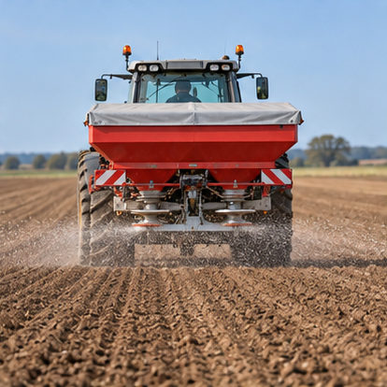
Variable-rate technology
A prescription specifies a rate for each location.
Navigation links the prescription with the moving machine.
The controller changes the application setting.
Applied-rate records support verification of the operation.
AI-generated illustration
AITrain
15
Notes:
Explain variable-rate technology. A prescription specifies a rate for each location. Navigation links the prescription with the moving machine. The controller changes the application setting. Applied-rate records support verification of the operation. Ask learners to connect the information with a concrete decision in their field of study.
Image: AI-generated illustrative scene. It represents the subject conceptually and does not document a specific farm, animal, product or measured result.

Slide 16
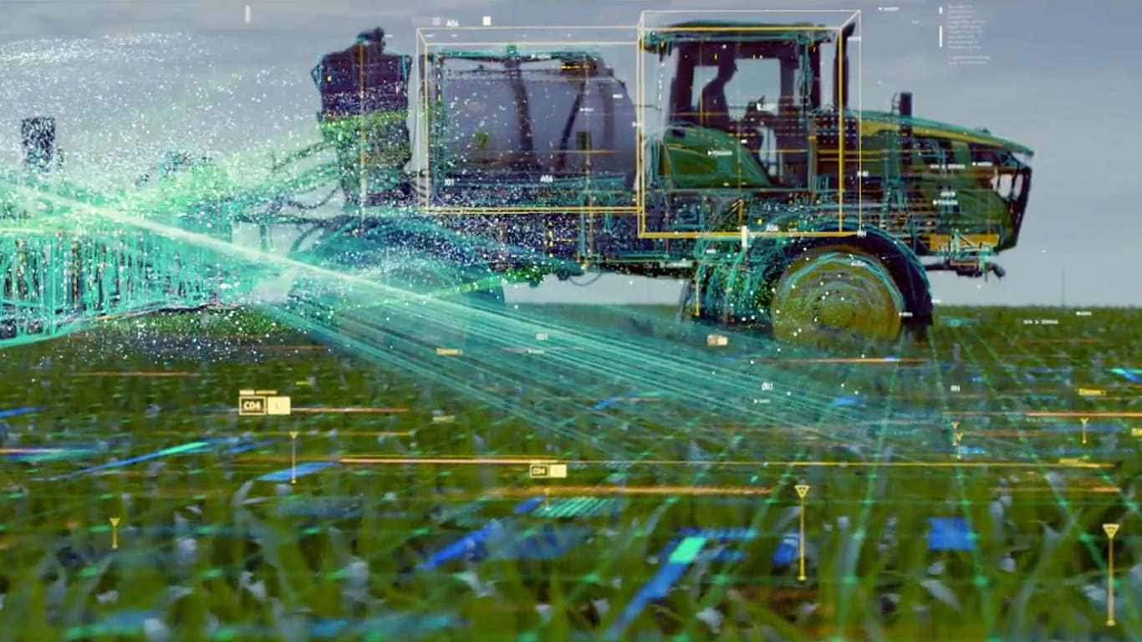
Targeted weed control
Cameras identify plants along the machine path.
Models locate weeds or classify treatment targets.
Actuators apply the selected intervention.
Detection errors and machine timing affect the result.
AITrain
16
Notes:
Explain targeted weed control. Cameras identify plants along the machine path. Models locate weeds or classify treatment targets. Actuators apply the selected intervention. Detection errors and machine timing affect the result. Ask learners to connect the information with a concrete decision in their field of study.
Image credit: John Deere See & Spray illustration. https://www.deere.com/en/sprayers/see-spray-gen-2/

Slide 17
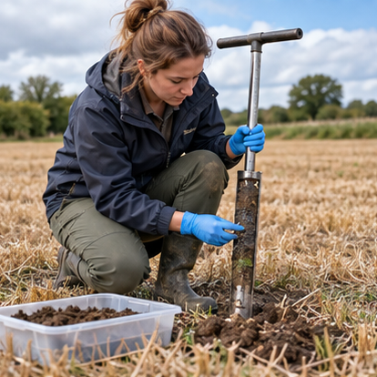
Soil-health monitoring
Sampling can track organic matter and nutrient conditions.
Field observations describe erosion and structural problems.
Digital maps connect measurements with locations.
Changes require interpretation over a suitable monitoring period.
AI-generated illustration
AITrain
17
Notes:
Explain soil-health monitoring. Sampling can track organic matter and nutrient conditions. Field observations describe erosion and structural problems. Digital maps connect measurements with locations. Changes require interpretation over a suitable monitoring period. Ask learners to connect the information with a concrete decision in their field of study.
Image: AI-generated illustrative scene. It represents the subject conceptually and does not document a specific farm, animal, product or measured result.

Slide 18
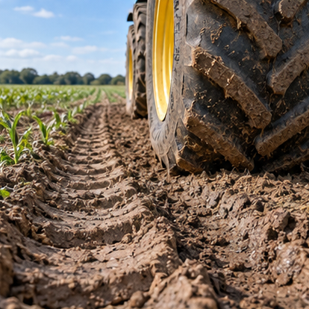
Compaction and erosion assessment
Machine traffic can change soil physical conditions.
Slope, cover and rainfall influence erosion risk.
Spatial observations support identification of vulnerable areas.
Management responses need checks under actual field conditions.
AI-generated illustration
AITrain
18
Notes:
Explain compaction and erosion assessment. Machine traffic can change soil physical conditions. Slope, cover and rainfall influence erosion risk. Spatial observations support identification of vulnerable areas. Management responses need checks under actual field conditions. Ask learners to connect the information with a concrete decision in their field of study.
Image: AI-generated illustrative scene. It represents the subject conceptually and does not document a specific farm, animal, product or measured result.

Slide 19
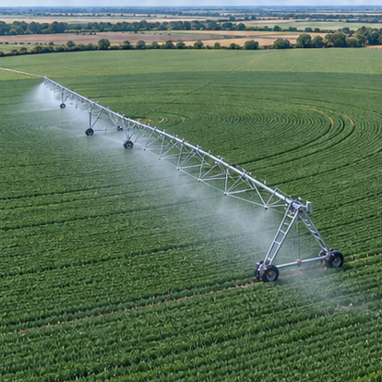
Water management and irrigation
Soil moisture describes selected root-zone conditions.
Crop development affects water demand.
Weather controls evaporation and transpiration.
Irrigation decisions should connect demand with delivered water.
AI-generated illustration
AITrain
19
Notes:
Explain water management and irrigation. Soil moisture describes selected root-zone conditions. Crop development affects water demand. Weather controls evaporation and transpiration. Irrigation decisions should connect demand with delivered water. Ask learners to connect the information with a concrete decision in their field of study.
Image: AI-generated illustrative scene. It represents the subject conceptually and does not document a specific farm, animal, product or measured result.

Slide 20
Evapotranspiration and crop demand
Evapotranspiration combines soil evaporation and plant transpiration.
Weather data help estimate atmospheric water demand.
Crop and soil information add local context.
Models can support forecasts of changing water requirements.
AITrain
20
Notes:
Explain evapotranspiration and crop demand. Evapotranspiration combines soil evaporation and plant transpiration. Weather data help estimate atmospheric water demand. Crop and soil information add local context. Models can support forecasts of changing water requirements. Ask learners to connect the information with a concrete decision in their field of study.

Slide 21
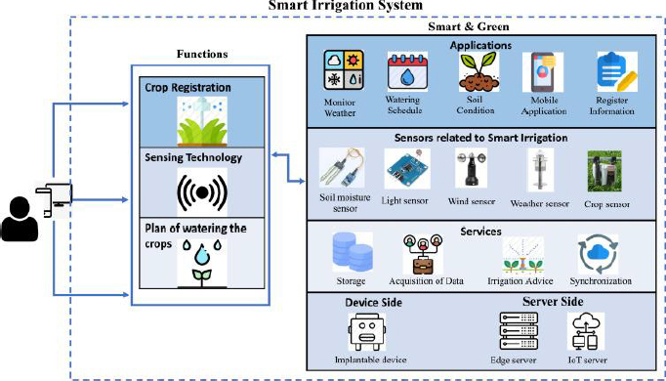
Monitoring and irrigation control
Sensors record soil conditions and irrigation events.
A scheduling model proposes timing or water quantity.
The controller operates the installation.
Flow and soil-response records verify the delivered action.
AITrain
21
Notes:
Explain monitoring and irrigation control. Sensors record soil conditions and irrigation events. A scheduling model proposes timing or water quantity. The controller operates the installation. Flow and soil-response records verify the delivered action. Ask learners to connect the information with a concrete decision in their field of study.

Slide 22
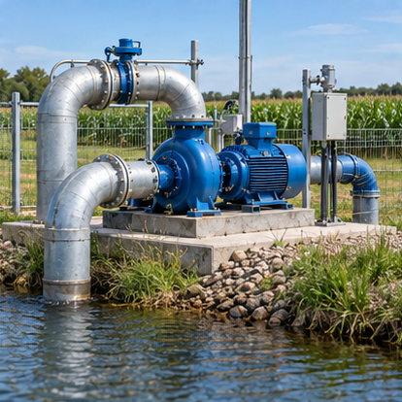
Energy use in agricultural operations
Pumping energy depends on the installation and operating conditions.
Machinery and protected cultivation create additional demand.
Monitoring links energy use with a defined operation.
Efficiency assessment needs comparable production conditions.
AI-generated illustration
AITrain
22
Notes:
Explain energy use in agricultural operations. Pumping energy depends on the installation and operating conditions. Machinery and protected cultivation create additional demand. Monitoring links energy use with a defined operation. Efficiency assessment needs comparable production conditions. Ask learners to connect the information with a concrete decision in their field of study.
Image: AI-generated illustrative scene. It represents the subject conceptually and does not document a specific farm, animal, product or measured result.

Slide 23
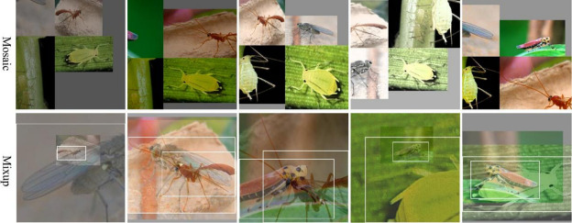
Crop monitoring and integrated protection
Imaging can locate unusual crop conditions.
Pest traps and field inspection provide complementary evidence.
Models support recognition and prioritise investigation.
Management choices should reflect pest pressure and crop context.
AITrain
23
Notes:
Explain crop monitoring and integrated protection. Imaging can locate unusual crop conditions. Pest traps and field inspection provide complementary evidence. Models support recognition and prioritise investigation. Management choices should reflect pest pressure and crop context. Ask learners to connect the information with a concrete decision in their field of study.

Slide 24
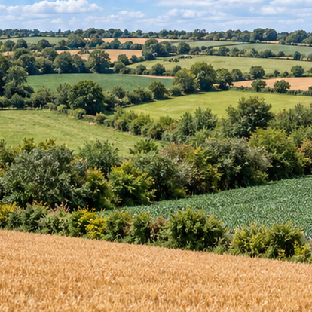
Climate resilience and biodiversity planning
Seasonal information supports adaptation of crop management.
Spatial data help examine crop and habitat patterns.
Scenarios can compare different management options.
Local observations test whether the selected strategy is suitable.
AI-generated illustration
AITrain
24
Notes:
Explain climate resilience and biodiversity planning. Seasonal information supports adaptation of crop management. Spatial data help examine crop and habitat patterns. Scenarios can compare different management options. Local observations test whether the selected strategy is suitable. Ask learners to connect the information with a concrete decision in their field of study.
Image: AI-generated illustrative scene. It represents the subject conceptually and does not document a specific farm, animal, product or measured result.

Slide 25
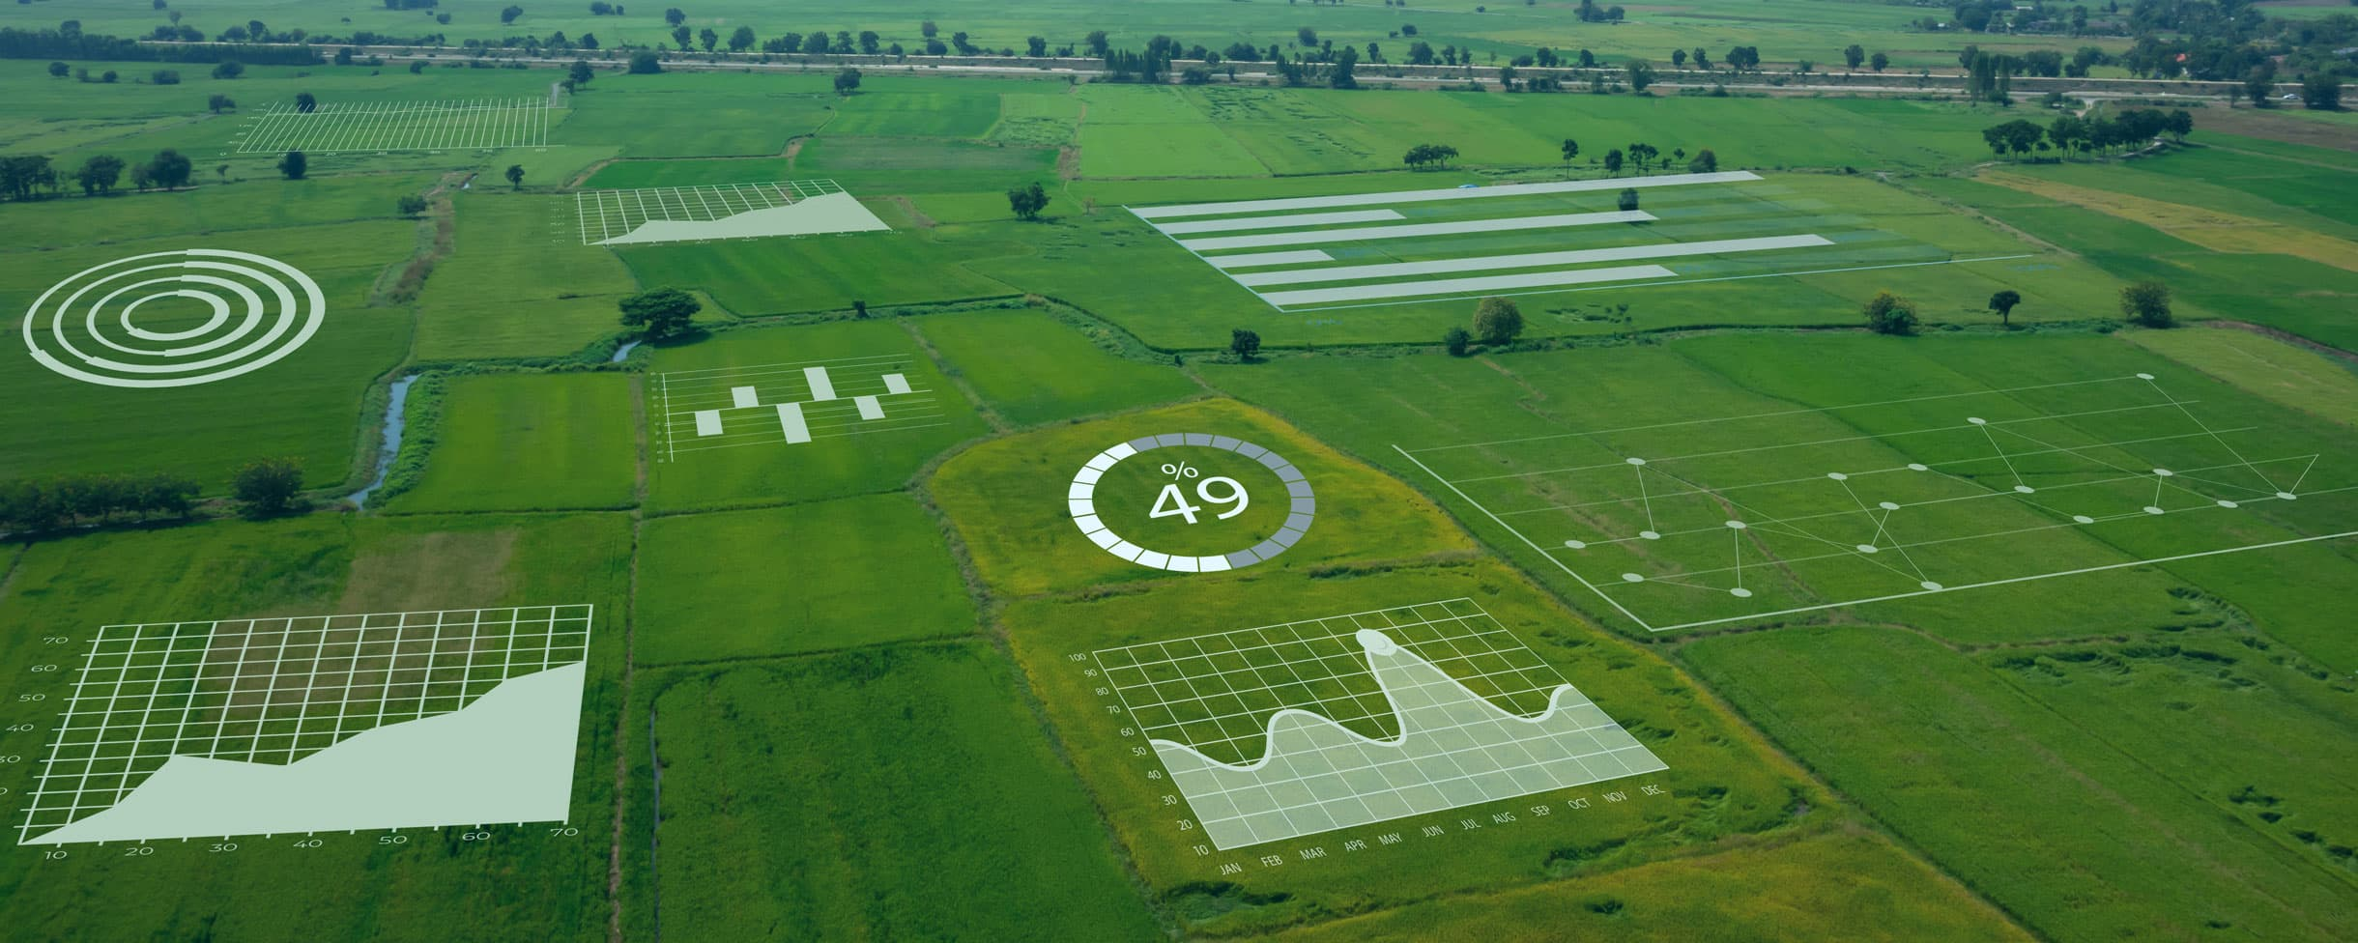
Digital twins for environmental decisions
A digital twin represents a field or production system.
Measurements update selected model variables.
Scenarios explore the effects of management changes.
Predicted effects require comparison with measured outcomes.
AITrain
25
Notes:
Explain digital twins for environmental decisions. A digital twin represents a field or production system. Measurements update selected model variables. Scenarios explore the effects of management changes. Predicted effects require comparison with measured outcomes. Ask learners to connect the information with a concrete decision in their field of study.
Image credit: Digital twin illustration. https://mentormate.com/blog/the-future-of-farming-7-ways-a-digital-twin-can-be-applied-to-agriculture/

Slide 26
Environmental indicators and comparison
Water use needs a stated area and reporting period.
Energy use needs a defined operation and unit.
Input changes need comparison with crop performance.
A baseline and common boundaries make comparisons meaningful.
AITrain
26
Notes:
Explain environmental indicators and comparison. Water use needs a stated area and reporting period. Energy use needs a defined operation and unit. Input changes need comparison with crop performance. A baseline and common boundaries make comparisons meaningful. Ask learners to connect the information with a concrete decision in their field of study.

Slide 27
Practical activity: two irrigation scenarios
Compare clearly defined irrigation strategies.
List the water, energy and crop records required.
Choose indicators with explicit units and boundaries.
Explain trade-offs and prepare a field verification plan.
AITrain
27
Notes:
Teaching exercise. Suggested indicators include water use in m³/ha and pumping electricity in kWh/ha. Specify the crop, season and system boundary. These are proposed evaluation measures, not reported performance results.

Slide 28
Evidence for environmental improvement
Define the management change and expected effect.
Collect comparable measurements before and after the change.
Consider weather and production differences.
Use measured outcomes to assess the environmental claim.
AITrain
28
Notes:
Explain evidence for environmental improvement. Define the management change and expected effect. Collect comparable measurements before and after the change. Consider weather and production differences. Use measured outcomes to assess the environmental claim. Ask learners to connect the information with a concrete decision in their field of study.

