Slide 1
AITrain
Food Production &
Processing Using AI
Quality, processing and information across the food chain
Assoc. Prof. Dr. Ovidiu Marian
AITrain Erasmus+ project
AITrain
01
Notes:
Explain food production &
processing using ai. Quality, processing and information across the food chain Assoc. Prof. Dr. Ovidiu Marian AITrain Erasmus+ project Ask learners to connect the information with a concrete decision in their field of study.

Slide 2
Learning outcomes
Explain the stages of the food production chain.
Identify sensors and AI applications in processing.
Describe shelf-life management and traceability.
Evaluate digital recommendations using process knowledge.
AITrain
02
Notes:
Explain learning outcomes. Explain the stages of the food production chain. Identify sensors and AI applications in processing. Describe shelf-life management and traceability. Evaluate digital recommendations using process knowledge. Ask learners to connect the information with a concrete decision in their field of study.

Slide 3
The food production chain
Primary production supplies agricultural raw materials.
Handling and storage affect their condition.
Processing transforms materials into food products.
Distribution and retail connect products with consumers.
AITrain
03
Notes:
Explain the food production chain. Primary production supplies agricultural raw materials. Handling and storage affect their condition. Processing transforms materials into food products. Distribution and retail connect products with consumers. Ask learners to connect the information with a concrete decision in their field of study.

Slide 4
AI methods in food systems
Classification assigns observations to defined categories.
Prediction estimates a future or difficult-to-measure value.
Anomaly detection identifies unusual operating patterns.
Computer vision interprets product and package images.
AITrain
04
Notes:
Explain ai methods in food systems. Classification assigns observations to defined categories. Prediction estimates a future or difficult-to-measure value. Anomaly detection identifies unusual operating patterns. Computer vision interprets product and package images. Ask learners to connect the information with a concrete decision in their field of study.

Slide 5
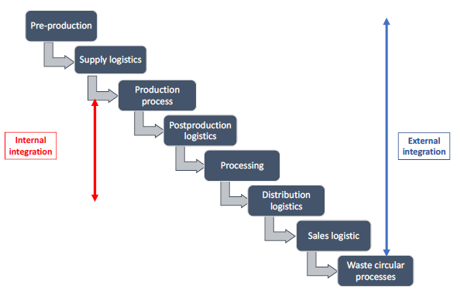
Data across the food chain
Farm records describe origin and production conditions.
Process records describe treatment and transformation.
Storage records document temperature and handling.
Batch identity links information across successive stages.
AITrain
05
Notes:
Explain data across the food chain. Farm records describe origin and production conditions. Process records describe treatment and transformation. Storage records document temperature and handling. Batch identity links information across successive stages. Ask learners to connect the information with a concrete decision in their field of study.

Slide 6
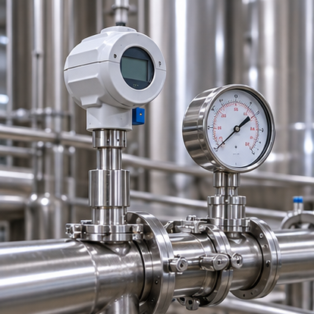
Sensors for food production
Temperature and humidity sensors monitor environmental conditions.
Pressure and flow measurements describe process operation.
pH and gas measurements support selected quality assessments.
Vibration and power records describe equipment condition.
AI-generated illustration
AITrain
06
Notes:
Explain sensors for food production. Temperature and humidity sensors monitor environmental conditions. Pressure and flow measurements describe process operation. pH and gas measurements support selected quality assessments. Vibration and power records describe equipment condition. Ask learners to connect the information with a concrete decision in their field of study.
Image: AI-generated illustrative scene. It represents the subject conceptually and does not document a specific farm, animal, product or measured result.

Slide 7
Raw data and usable information
Measurements need timestamps and explicit units.
Calibration connects readings with reference values.
Data processing identifies gaps and inconsistent observations.
Interpretation requires knowledge of the food and process.
AITrain
07
Notes:
Explain raw data and usable information. Measurements need timestamps and explicit units. Calibration connects readings with reference values. Data processing identifies gaps and inconsistent observations. Interpretation requires knowledge of the food and process. Ask learners to connect the information with a concrete decision in their field of study.

Slide 8
Crop production and raw-material quality
Crop management affects the condition of harvested material.
Harvest timing influences maturity and handling requirements.
Inspection can identify visible damage or impurities.
Production records provide context for processing decisions.
AITrain
08
Notes:
Explain crop production and raw-material quality. Crop management affects the condition of harvested material. Harvest timing influences maturity and handling requirements. Inspection can identify visible damage or impurities. Production records provide context for processing decisions. Ask learners to connect the information with a concrete decision in their field of study.

Slide 9
Livestock and food quality
Animal health and nutrition affect production performance.
Monitoring helps identify animals that need attention.
Milk and growth records connect management with output.
Handling and hygiene remain essential after primary production.
AITrain
09
Notes:
Explain livestock and food quality. Animal health and nutrition affect production performance. Monitoring helps identify animals that need attention. Milk and growth records connect management with output. Handling and hygiene remain essential after primary production. Ask learners to connect the information with a concrete decision in their field of study.

Slide 10
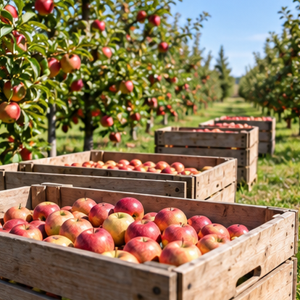
Harvesting and first handling
Material condition determines suitable handling methods.
Mechanical damage can reduce quality during later stages.
Moisture influences storage and drying needs.
Identification should begin before batches enter processing.
AI-generated illustration
AITrain
10
Notes:
Explain harvesting and first handling. Material condition determines suitable handling methods. Mechanical damage can reduce quality during later stages. Moisture influences storage and drying needs. Identification should begin before batches enter processing. Ask learners to connect the information with a concrete decision in their field of study.
Image: AI-generated illustrative scene. It represents the subject conceptually and does not document a specific farm, animal, product or measured result.

Slide 11
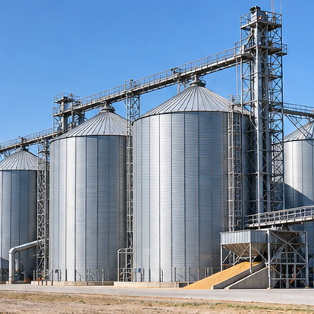
Storage and product condition
Temperature influences deterioration processes.
Humidity affects moisture exchange and storage behaviour.
Packaging changes the product’s surrounding environment.
Monitoring records support timely handling decisions.
AI-generated illustration
AITrain
11
Notes:
Explain storage and product condition. Temperature influences deterioration processes. Humidity affects moisture exchange and storage behaviour. Packaging changes the product’s surrounding environment. Monitoring records support timely handling decisions. Ask learners to connect the information with a concrete decision in their field of study.
Image: AI-generated illustrative scene. It represents the subject conceptually and does not document a specific farm, animal, product or measured result.

Slide 12
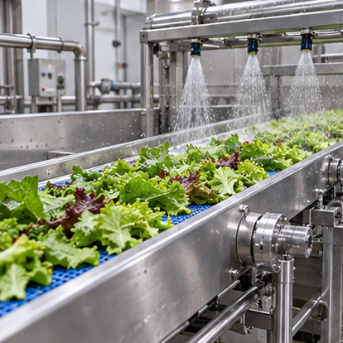
The food processing line
Cleaning and sorting prepare raw material.
Cutting, mixing or milling change its form.
Heating, cooling or drying modify product conditions.
Packaging protects and identifies the finished product.
AI-generated illustration
AITrain
12
Notes:
Explain the food processing line. Cleaning and sorting prepare raw material. Cutting, mixing or milling change its form. Heating, cooling or drying modify product conditions. Packaging protects and identifies the finished product. Ask learners to connect the information with a concrete decision in their field of study.
Image: AI-generated illustrative scene. It represents the subject conceptually and does not document a specific farm, animal, product or measured result.

Slide 13
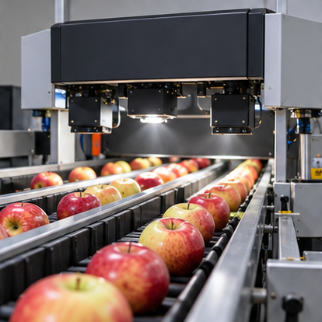
Vision-based sorting and grading
Cameras measure visible product features.
Models can classify size, colour or surface damage.
The sorter directs products to selected destinations.
Lighting and product presentation affect inspection performance.
AI-generated illustration
AITrain
13
Notes:
Explain vision-based sorting and grading. Cameras measure visible product features. Models can classify size, colour or surface damage. The sorter directs products to selected destinations. Lighting and product presentation affect inspection performance. Ask learners to connect the information with a concrete decision in their field of study.
Image: AI-generated illustrative scene. It represents the subject conceptually and does not document a specific farm, animal, product or measured result.

Slide 14
Quality control during processing
Process measurements describe operating conditions.
Models can estimate quality-related variables.
Abnormal patterns can trigger operator inspection.
Reference tests help confirm the interpretation.
AITrain
14
Notes:
Explain quality control during processing. Process measurements describe operating conditions. Models can estimate quality-related variables. Abnormal patterns can trigger operator inspection. Reference tests help confirm the interpretation. Ask learners to connect the information with a concrete decision in their field of study.

Slide 15
Food safety and contamination detection
Imaging systems can support foreign-object detection.
Sensor records can reveal abnormal process conditions.
An alert needs a defined investigation procedure.
Safety decisions require validated checks and responsible staff.
AITrain
15
Notes:
Explain food safety and contamination detection. Imaging systems can support foreign-object detection. Sensor records can reveal abnormal process conditions. An alert needs a defined investigation procedure. Safety decisions require validated checks and responsible staff. Ask learners to connect the information with a concrete decision in their field of study.

Slide 16
Process control and resource use
A controller changes the selected operating variable.
A model can support prediction or parameter selection.
Energy and product measurements reveal process performance.
Changes need checks of quality and operating requirements.
AITrain
16
Notes:
Explain process control and resource use. A controller changes the selected operating variable. A model can support prediction or parameter selection. Energy and product measurements reveal process performance. Changes need checks of quality and operating requirements. Ask learners to connect the information with a concrete decision in their field of study.

Slide 17
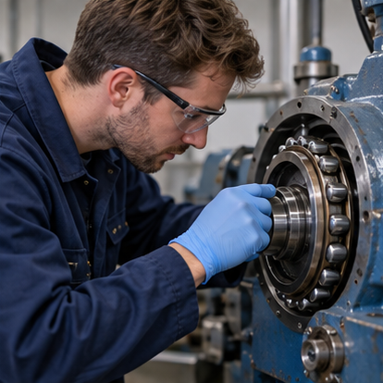
Predictive maintenance
Vibration can reveal changes in rotating equipment.
Temperature and power use add condition information.
Models compare present behaviour with normal operation.
Maintenance staff investigate the alert and plan the response.
AI-generated illustration
AITrain
17
Notes:
Explain predictive maintenance. Vibration can reveal changes in rotating equipment. Temperature and power use add condition information. Models compare present behaviour with normal operation. Maintenance staff investigate the alert and plan the response. Ask learners to connect the information with a concrete decision in their field of study.
Image: AI-generated illustrative scene. It represents the subject conceptually and does not document a specific farm, animal, product or measured result.

Slide 18
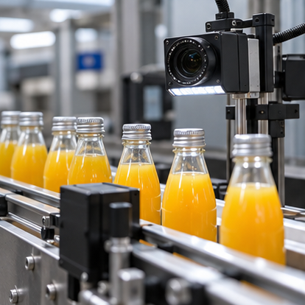
Packaging inspection
Cameras can inspect labels and product presentation.
Models can identify missing caps or visible package damage.
Seal and filling checks support production control.
Batch codes connect packages with production records.
AI-generated illustration
AITrain
18
Notes:
Explain packaging inspection. Cameras can inspect labels and product presentation. Models can identify missing caps or visible package damage. Seal and filling checks support production control. Batch codes connect packages with production records. Ask learners to connect the information with a concrete decision in their field of study.
Image: AI-generated illustrative scene. It represents the subject conceptually and does not document a specific farm, animal, product or measured result.

Slide 19
Freshness and shelf-life prediction
Deterioration depends on the product and its exposure history.
Models combine measurements with reference observations.
Predictions can support handling and stock rotation.
The model must match the product and intended use.
AITrain
19
Notes:
Explain freshness and shelf-life prediction. Deterioration depends on the product and its exposure history. Models combine measurements with reference observations. Predictions can support handling and stock rotation. The model must match the product and intended use. Ask learners to connect the information with a concrete decision in their field of study.

Slide 20
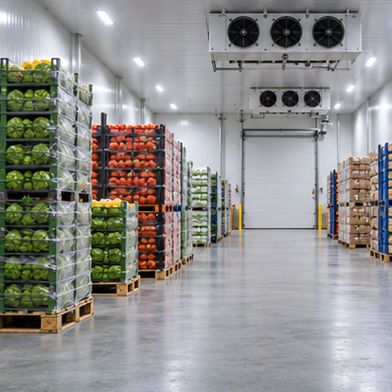
Cold-chain monitoring
Temperature records describe storage and transport exposure.
An excursion requires checks of duration and data reliability.
Product specifications guide the handling response.
Batch records document the event and the final action.
AI-generated illustration
AITrain
20
Notes:
Explain cold-chain monitoring. Temperature records describe storage and transport exposure. An excursion requires checks of duration and data reliability. Product specifications guide the handling response. Batch records document the event and the final action. Ask learners to connect the information with a concrete decision in their field of study.
Image: AI-generated illustrative scene. It represents the subject conceptually and does not document a specific farm, animal, product or measured result.

Slide 21
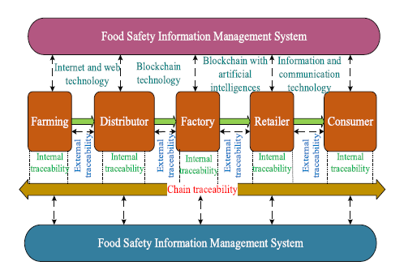
Traceability within and between organisations
Internal records follow material through one organisation.
External records connect successive supply-chain stages.
Backward tracing identifies the origin of a batch.
Forward tracing identifies where affected products travelled.
AITrain
21
Notes:
Explain traceability within and between organisations. Internal records follow material through one organisation. External records connect successive supply-chain stages. Backward tracing identifies the origin of a batch. Forward tracing identifies where affected products travelled. Ask learners to connect the information with a concrete decision in their field of study.

Slide 22
QR codes, RFID and digital records
Codes and tags provide links to product information.
Readers connect identity with handling events.
Digital platforms combine records across locations.
Accurate data entry remains essential for traceability.
AITrain
22
Notes:
Explain qr codes, rfid and digital records. Codes and tags provide links to product information. Readers connect identity with handling events. Digital platforms combine records across locations. Accurate data entry remains essential for traceability. Ask learners to connect the information with a concrete decision in their field of study.

Slide 23
Demand forecasting and logistics
Sales and stock records describe demand patterns.
Forecasts support purchasing and production planning.
Route and storage decisions influence delivery performance.
Planning should account for product perishability.
AITrain
23
Notes:
Explain demand forecasting and logistics. Sales and stock records describe demand patterns. Forecasts support purchasing and production planning. Route and storage decisions influence delivery performance. Planning should account for product perishability. Ask learners to connect the information with a concrete decision in their field of study.

Slide 24
Food loss and waste reduction
Losses can arise during handling, storage and processing.
Monitoring helps identify where deterioration occurs.
Forecasting can reduce mismatch between supply and demand.
Measured losses show whether a change improves performance.
AITrain
24
Notes:
Explain food loss and waste reduction. Losses can arise during handling, storage and processing. Monitoring helps identify where deterioration occurs. Forecasting can reduce mismatch between supply and demand. Measured losses show whether a change improves performance. Ask learners to connect the information with a concrete decision in their field of study.

Slide 25
Soft sensors and digital twins
A soft sensor estimates a variable from other measurements.
A drying model may estimate moisture from operating data.
A digital twin represents a product or production process.
Both approaches need comparison with reference observations.
AITrain
25
Notes:
Explain soft sensors and digital twins. A soft sensor estimates a variable from other measurements. A drying model may estimate moisture from operating data. A digital twin represents a product or production process. Both approaches need comparison with reference observations. Ask learners to connect the information with a concrete decision in their field of study.

Slide 26
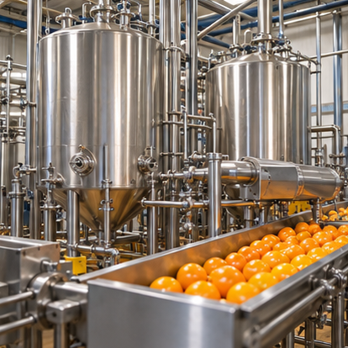
Worked application: a juice factory
Fruit inspection supports raw-material selection.
Process sensors monitor temperature and operating conditions.
Packaging checks confirm labels and visible integrity.
Batch records connect raw material with the finished product.
AI-generated illustration
AITrain
26
Notes:
Application scenario. Explain where each measurement enters the production workflow. Ask learners to separate a quality prediction from a control action, and to identify which checks require physical inspection or laboratory evidence.
Image: AI-generated illustrative scene. It represents the subject conceptually and does not document a specific farm, animal, product or measured result.

Slide 27
Practical activity: a cold-chain event
Inspect a batch temperature record for an excursion.
Check sensor reliability and exposure duration.
Identify the additional product information required.
Prepare a justified handling decision and event record.
AITrain
27
Notes:
Teaching exercise. Supply a product specification and clearly labelled temperature data. Evaluate how learners use evidence, recognise uncertainty and document a handling decision. Temperature alone does not establish product safety.

Slide 28
A defensible food-system decision
Use calibrated measurements linked to the right batch.
Validate the model for the product and process.
Connect alerts with operational procedures.
Record the responsible person, action and follow-up result.
AITrain
28
Notes:
Explain a defensible food-system decision. Use calibrated measurements linked to the right batch. Validate the model for the product and process. Connect alerts with operational procedures. Record the responsible person, action and follow-up result. Ask learners to connect the information with a concrete decision in their field of study.

