Slide 1
AITrain
Livestock Management
with AI
Animal monitoring, welfare and production decisions
Assoc. Prof. Dr. Ovidiu Marian
AITrain Erasmus+ project
AITrain
01
Notes:
Explain livestock management
with ai. Animal monitoring, welfare and production decisions Assoc. Prof. Dr. Ovidiu Marian AITrain Erasmus+ project Ask learners to connect the information with a concrete decision in their field of study.

Slide 2
Learning outcomes
Describe the main livestock systems and their data needs.
Identify technologies for individual animal monitoring.
Explain AI support for health, feeding and reproduction.
Interpret alerts and plan appropriate checks.
AITrain
02
Notes:
Explain learning outcomes. Describe the main livestock systems and their data needs. Identify technologies for individual animal monitoring. Explain AI support for health, feeding and reproduction. Interpret alerts and plan appropriate checks. Ask learners to connect the information with a concrete decision in their field of study.

Slide 3
Livestock farming as a biological system
Animals convert feed into products and growth.
Health and welfare influence biological performance.
Housing and environmental conditions affect daily behaviour.
Management must account for species and production stage.
AITrain
03
Notes:
Explain livestock farming as a biological system. Animals convert feed into products and growth. Health and welfare influence biological performance. Housing and environmental conditions affect daily behaviour. Management must account for species and production stage. Ask learners to connect the information with a concrete decision in their field of study.

Slide 4
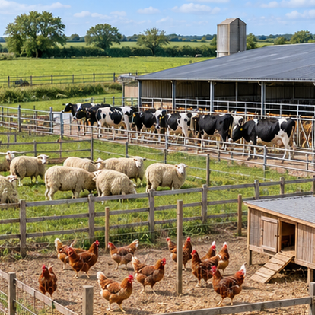
Production systems and species
Dairy systems monitor milk output and reproductive performance.
Meat systems follow body weight and growth.
Poultry systems monitor flock conditions and production.
Grazing systems also need spatial and pasture information.
AI-generated illustration
AITrain
04
Notes:
Explain production systems and species. Dairy systems monitor milk output and reproductive performance. Meat systems follow body weight and growth. Poultry systems monitor flock conditions and production. Grazing systems also need spatial and pasture information. Ask learners to connect the information with a concrete decision in their field of study.
Image: AI-generated illustrative scene. It represents the subject conceptually and does not document a specific farm, animal, product or measured result.

Slide 5
Precision Livestock Farming
Continuous monitoring records animals and their environment.
Individual records reveal changes hidden by group averages.
Digital systems connect measurements with management tasks.
AI adds classification, prediction and anomaly detection.
AITrain
05
Notes:
Explain precision livestock farming. Continuous monitoring records animals and their environment. Individual records reveal changes hidden by group averages. Digital systems connect measurements with management tasks. AI adds classification, prediction and anomaly detection. Ask learners to connect the information with a concrete decision in their field of study.

Slide 6
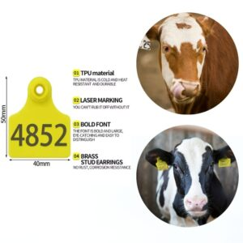
Animal identification
RFID tags associate records with individual animals.
Readers capture identity at feeding or handling points.
Cameras can support visual identification.
Reliable identity prevents records from mixing between animals.
AITrain
06
Notes:
Explain animal identification. RFID tags associate records with individual animals. Readers capture identity at feeding or handling points. Cameras can support visual identification. Reliable identity prevents records from mixing between animals. Ask learners to connect the information with a concrete decision in their field of study.
Image credit: RFID livestock identification illustration. https://rfidlivestock.com/blog/how-to-make-custom-cattle-ear-tags-duplicate-1/

Slide 7
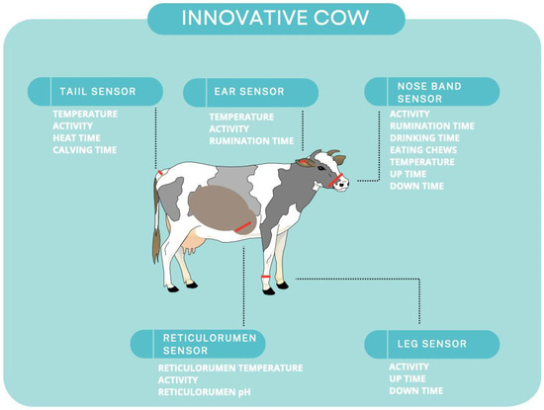
Wearable sensors
Accelerometers measure changes in movement.
Collars, ear tags and leg bands support monitoring.
Some systems estimate activity or rumination patterns.
Attachment, position and maintenance affect measurement quality.
AITrain
07
Notes:
Explain wearable sensors. Accelerometers measure changes in movement. Collars, ear tags and leg bands support monitoring. Some systems estimate activity or rumination patterns. Attachment, position and maintenance affect measurement quality. Ask learners to connect the information with a concrete decision in their field of study.

Slide 8
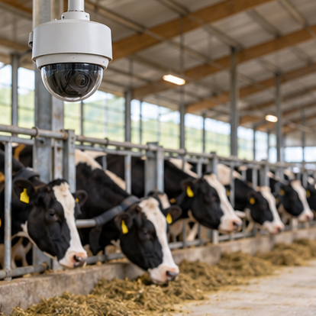
Cameras, depth sensors and microphones
RGB cameras record visible posture and behaviour.
Depth cameras support body-shape measurements.
Thermal imaging records surface-temperature patterns.
Microphones capture vocalisations and respiratory sounds.
AI-generated illustration
AITrain
08
Notes:
Explain cameras, depth sensors and microphones. RGB cameras record visible posture and behaviour. Depth cameras support body-shape measurements. Thermal imaging records surface-temperature patterns. Microphones capture vocalisations and respiratory sounds. Ask learners to connect the information with a concrete decision in their field of study.
Image: AI-generated illustrative scene. It represents the subject conceptually and does not document a specific farm, animal, product or measured result.

Slide 9
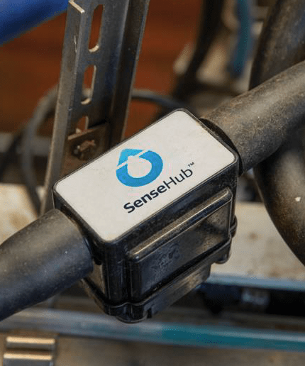
Production and environmental measurements
Milk meters record individual production.
Weighing systems track body mass over time.
Feed and water records describe resource intake.
Temperature and humidity sensors describe housing conditions.
AITrain
09
Notes:
Explain production and environmental measurements. Milk meters record individual production. Weighing systems track body mass over time. Feed and water records describe resource intake. Temperature and humidity sensors describe housing conditions. Ask learners to connect the information with a concrete decision in their field of study.
Image credit: SenseHub MilkPlus. https://www.sensehub.co.nz/monitoring/milkplus/

Slide 10
Data organisation and quality
Every observation needs identity, time and units.
Missing records can conceal a change in behaviour.
Sensor drift can resemble biological change.
Routine checks distinguish technical faults from animal events.
AITrain
10
Notes:
Explain data organisation and quality. Every observation needs identity, time and units. Missing records can conceal a change in behaviour. Sensor drift can resemble biological change. Routine checks distinguish technical faults from animal events. Ask learners to connect the information with a concrete decision in their field of study.

Slide 11
The AI monitoring workflow
Measurements describe the animal and its environment.
Processing converts raw signals into useful features.
Models estimate behaviour, risk or expected performance.
Alerts direct staff to animals that require attention.
AITrain
11
Notes:
Explain the ai monitoring workflow. Measurements describe the animal and its environment. Processing converts raw signals into useful features. Models estimate behaviour, risk or expected performance. Alerts direct staff to animals that require attention. Ask learners to connect the information with a concrete decision in their field of study.

Slide 12
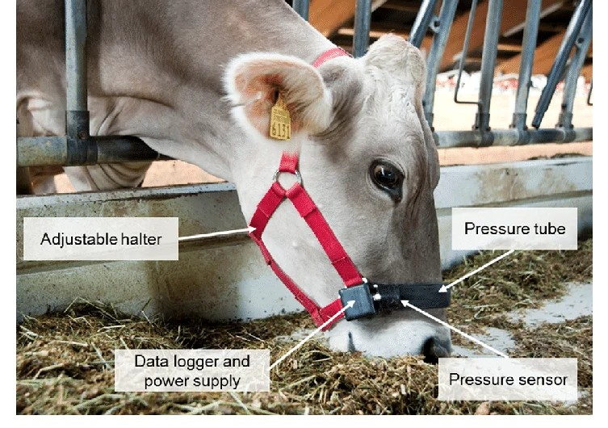
Individual baselines and anomalies
A baseline describes the usual pattern for an animal.
A deviation can signal a management or health event.
Several signals provide context for the same event.
The alert threshold affects missed events and false alarms.
AITrain
12
Notes:
Explain individual baselines and anomalies. A baseline describes the usual pattern for an animal. A deviation can signal a management or health event. Several signals provide context for the same event. The alert threshold affects missed events and false alarms. Ask learners to connect the information with a concrete decision in their field of study.
Image credit: RumiWatch. https://www.rumiwatch.com/

Slide 13
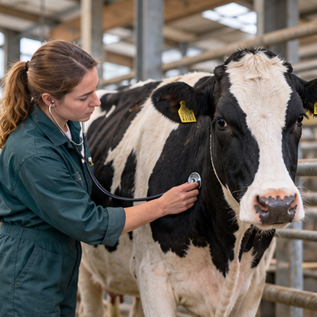
Early health monitoring
Activity changes can indicate a need for inspection.
Reduced rumination or intake can accompany health problems.
Production records add context to behaviour changes.
Direct examination determines the appropriate response.
AI-generated illustration
AITrain
13
Notes:
Explain early health monitoring. Activity changes can indicate a need for inspection. Reduced rumination or intake can accompany health problems. Production records add context to behaviour changes. Direct examination determines the appropriate response. Ask learners to connect the information with a concrete decision in their field of study.
Image: AI-generated illustrative scene. It represents the subject conceptually and does not document a specific farm, animal, product or measured result.

Slide 14
Mastitis monitoring
Milk-yield and milk-property changes can support screening.
Conductivity records can contribute to an alert.
The animal’s history helps interpret the signal.
Veterinary assessment and appropriate tests confirm the problem.
AITrain
14
Notes:
Explain mastitis monitoring. Milk-yield and milk-property changes can support screening. Conductivity records can contribute to an alert. The animal’s history helps interpret the signal. Veterinary assessment and appropriate tests confirm the problem. Ask learners to connect the information with a concrete decision in their field of study.

Slide 15
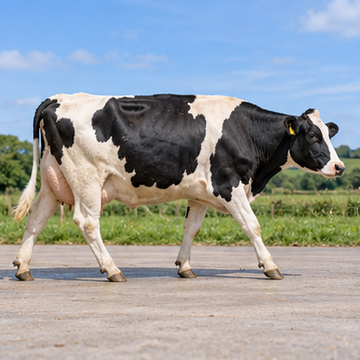
Lameness and movement assessment
Walking patterns can change with impaired locomotion.
Computer vision can analyse posture and movement.
Activity sensors can show changes in walking or lying.
Staff inspect the animal and identify the cause.
AI-generated illustration
AITrain
15
Notes:
Explain lameness and movement assessment. Walking patterns can change with impaired locomotion. Computer vision can analyse posture and movement. Activity sensors can show changes in walking or lying. Staff inspect the animal and identify the cause. Ask learners to connect the information with a concrete decision in their field of study.
Image: AI-generated illustrative scene. It represents the subject conceptually and does not document a specific farm, animal, product or measured result.

Slide 16
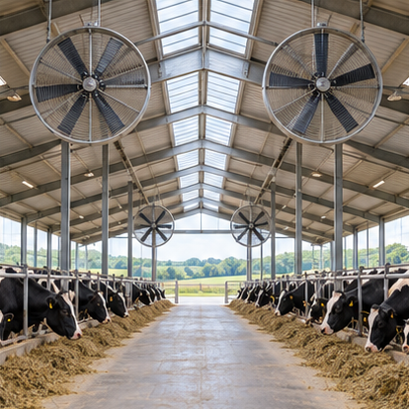
Welfare and heat stress
Lying, feeding and drinking patterns inform assessment.
Housing temperature and humidity provide environmental context.
Abnormal behaviour can reveal access or comfort problems.
Management responses need checks of both animals and housing.
AI-generated illustration
AITrain
16
Notes:
Explain welfare and heat stress. Lying, feeding and drinking patterns inform assessment. Housing temperature and humidity provide environmental context. Abnormal behaviour can reveal access or comfort problems. Management responses need checks of both animals and housing. Ask learners to connect the information with a concrete decision in their field of study.
Image: AI-generated illustrative scene. It represents the subject conceptually and does not document a specific farm, animal, product or measured result.

Slide 17
Respiratory monitoring and sound
Microphones can detect changes in coughing patterns.
Models distinguish sound events using labelled examples.
Background noise can interfere with detection.
A sound alert supports inspection of the affected group.
AITrain
17
Notes:
Explain respiratory monitoring and sound. Microphones can detect changes in coughing patterns. Models distinguish sound events using labelled examples. Background noise can interfere with detection. A sound alert supports inspection of the affected group. Ask learners to connect the information with a concrete decision in their field of study.

Slide 18
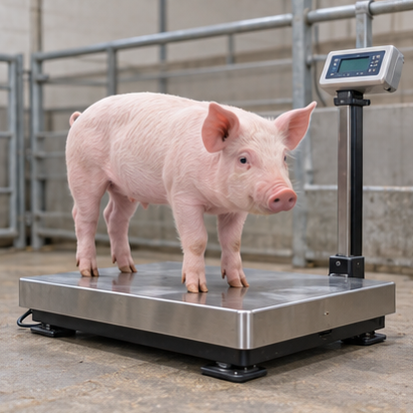
Body weight and growth monitoring
Regular weighing describes the growth trajectory.
Vision systems can estimate weight from body features.
Models require comparison with reference weights.
Changes in growth need interpretation alongside feed and health.
AI-generated illustration
AITrain
18
Notes:
Explain body weight and growth monitoring. Regular weighing describes the growth trajectory. Vision systems can estimate weight from body features. Models require comparison with reference weights. Changes in growth need interpretation alongside feed and health. Ask learners to connect the information with a concrete decision in their field of study.
Image: AI-generated illustrative scene. It represents the subject conceptually and does not document a specific farm, animal, product or measured result.

Slide 19
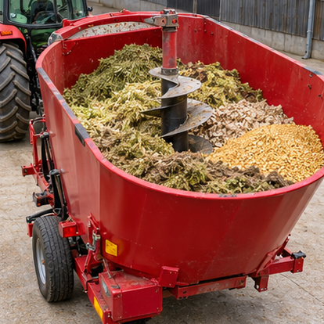
Precision feeding
Nutrient needs vary with species and production stage.
Intake, weight and output provide decision inputs.
Models can support ration adjustment and feeding schedules.
Farm staff check the biological response after a change.
AI-generated illustration
AITrain
19
Notes:
Explain precision feeding. Nutrient needs vary with species and production stage. Intake, weight and output provide decision inputs. Models can support ration adjustment and feeding schedules. Farm staff check the biological response after a change. Ask learners to connect the information with a concrete decision in their field of study.
Image: AI-generated illustrative scene. It represents the subject conceptually and does not document a specific farm, animal, product or measured result.

Slide 20
Feed efficiency and environmental effects
Feed use must relate to the relevant production output.
Group and individual records answer different questions.
Improved allocation can reduce avoidable feed losses.
Environmental assessment also needs measured resource records.
AITrain
20
Notes:
Explain feed efficiency and environmental effects. Feed use must relate to the relevant production output. Group and individual records answer different questions. Improved allocation can reduce avoidable feed losses. Environmental assessment also needs measured resource records. Ask learners to connect the information with a concrete decision in their field of study.

Slide 21
Reproductive monitoring
Activity patterns can support oestrus detection.
Health and production records add useful context.
Alerts help schedule observation and reproductive management.
Staff confirm events before selecting an intervention.
AITrain
21
Notes:
Explain reproductive monitoring. Activity patterns can support oestrus detection. Health and production records add useful context. Alerts help schedule observation and reproductive management. Staff confirm events before selecting an intervention. Ask learners to connect the information with a concrete decision in their field of study.

Slide 22
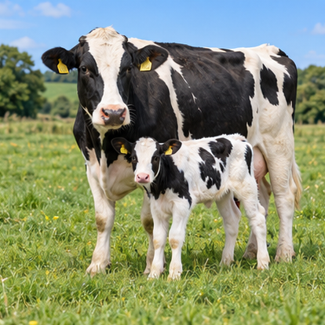
Breeding and longer-term records
Breeding decisions use performance and pedigree information.
AI can examine patterns across large datasets.
Data quality affects the reliability of selection support.
Breeding objectives must reflect the production system.
AI-generated illustration
AITrain
22
Notes:
Explain breeding and longer-term records. Breeding decisions use performance and pedigree information. AI can examine patterns across large datasets. Data quality affects the reliability of selection support. Breeding objectives must reflect the production system. Ask learners to connect the information with a concrete decision in their field of study.
Image: AI-generated illustrative scene. It represents the subject conceptually and does not document a specific farm, animal, product or measured result.

Slide 23
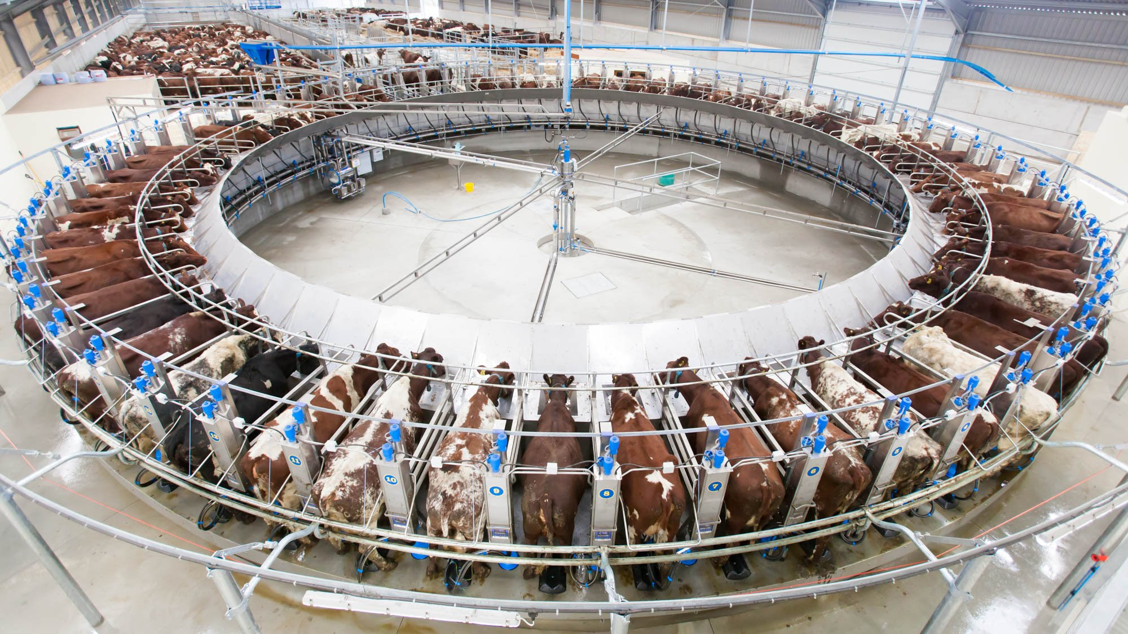
Automatic milking
Identification links each visit to the correct animal.
Equipment records milk yield and operating information.
Monitoring supports inspection of unusual visits.
Staff supervise hygiene, animal access and machine condition.
AITrain
23
Notes:
Explain automatic milking. Identification links each visit to the correct animal. Equipment records milk yield and operating information. Monitoring supports inspection of unusual visits. Staff supervise hygiene, animal access and machine condition. Ask learners to connect the information with a concrete decision in their field of study.
Image credit: Dairymaster rotary milking equipment. https://www.dairymaster.com/zh-hans/products/milking/cow-rotary/

Slide 24
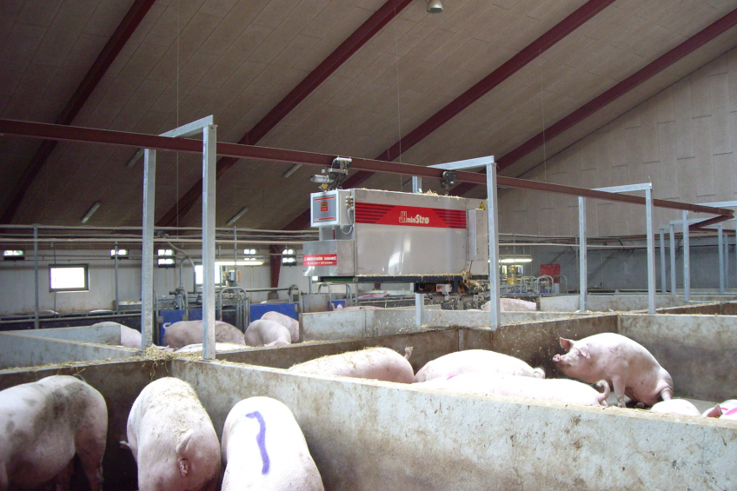
Automated feeding and cleaning
Feeding systems prepare or deliver planned feed quantities.
Cleaning equipment supports routine sanitation tasks.
Sensors monitor equipment operation and farm conditions.
Automation needs inspection, maintenance and trained operators.
AITrain
24
Notes:
Explain automated feeding and cleaning. Feeding systems prepare or deliver planned feed quantities. Cleaning equipment supports routine sanitation tasks. Sensors monitor equipment operation and farm conditions. Automation needs inspection, maintenance and trained operators. Ask learners to connect the information with a concrete decision in their field of study.
Image credit: Pig Progress, automatic on-rail feeding mixer system. https://www.pigprogress.net/pigs/automatic-on-rail-feeding-mixer-system-for-sows/

Slide 25
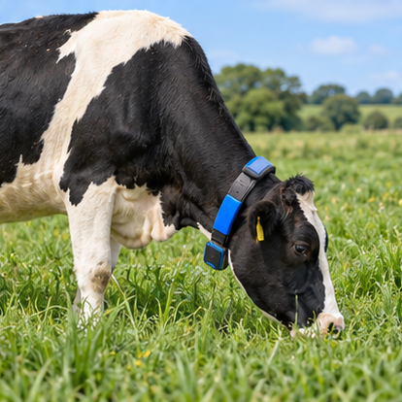
Monitoring grazing animals
GNSS records animal movement and distribution.
Remote sensing helps describe pasture conditions.
Spatial records support grazing-management decisions.
Connectivity and battery life affect field operation.
AI-generated illustration
AITrain
25
Notes:
Explain monitoring grazing animals. GNSS records animal movement and distribution. Remote sensing helps describe pasture conditions. Spatial records support grazing-management decisions. Connectivity and battery life affect field operation. Ask learners to connect the information with a concrete decision in their field of study.
Image: AI-generated illustrative scene. It represents the subject conceptually and does not document a specific farm, animal, product or measured result.

Slide 26
Digital twins and future applications
A digital twin models part of the farm system.
Measurements update the model’s representation.
Scenarios can explore feeding or management choices.
Predictions require checks against actual farm performance.
AITrain
26
Notes:
Explain digital twins and future applications. A digital twin models part of the farm system. Measurements update the model’s representation. Scenarios can explore feeding or management choices. Predictions require checks against actual farm performance. Ask learners to connect the information with a concrete decision in their field of study.

Slide 27
Practical activity: an animal alert
Review activity, rumination and milk-yield records.
Compare the change with the animal’s baseline.
Check data gaps and the housing environment.
Prepare a prioritised inspection recommendation.
AITrain
27
Notes:
Teaching exercise. Use anonymised records or clearly labelled simulated observations. Ask learners to explain several possible causes and the checks needed to distinguish them. Assess alert interpretation and the proposed inspection sequence.

Slide 28
A reliable livestock-monitoring system
Identity and data quality support meaningful records.
Useful alerts connect to a clear inspection procedure.
Trained staff interpret biological and technical changes.
Follow-up records show whether the intervention worked.
AITrain
28
Notes:
Explain a reliable livestock-monitoring system. Identity and data quality support meaningful records. Useful alerts connect to a clear inspection procedure. Trained staff interpret biological and technical changes. Follow-up records show whether the intervention worked. Ask learners to connect the information with a concrete decision in their field of study.

