Slide 1
AITrain
Plant Production &
Crop Management
Agronomy, sensing and AI in crop decisions
Lecturer Dr. Alexandru Bogdan Ghețe
AITrain Erasmus+ project
AITrain
01
Notes:
Explain plant production &
crop management. Agronomy, sensing and AI in crop decisions Lecturer Dr. Alexandru Bogdan Ghețe AITrain Erasmus+ project Ask learners to connect the information with a concrete decision in their field of study.

Slide 2
Learning outcomes
Explain the main factors that influence crop performance.
Connect field measurements with management decisions.
Describe AI applications throughout the crop cycle.
Check recommendations using agronomic evidence.
AITrain
02
Notes:
Explain learning outcomes. Explain the main factors that influence crop performance. Connect field measurements with management decisions. Describe AI applications throughout the crop cycle. Check recommendations using agronomic evidence. Ask learners to connect the information with a concrete decision in their field of study.

Slide 3
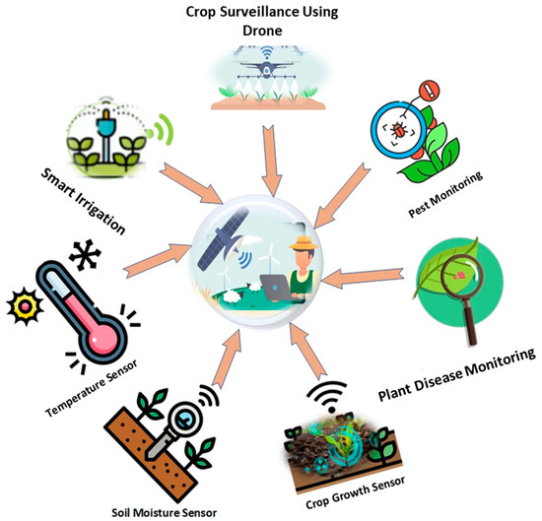
The crop production system
Soil supplies rooting space, water and nutrients.
Climate sets the conditions for crop development.
Management changes planting, nutrition and protection.
Harvesting and storage determine the usable output.
AITrain
03
Notes:
Explain the crop production system. Soil supplies rooting space, water and nutrients. Climate sets the conditions for crop development. Management changes planting, nutrition and protection. Harvesting and storage determine the usable output. Ask learners to connect the information with a concrete decision in their field of study.

Slide 4
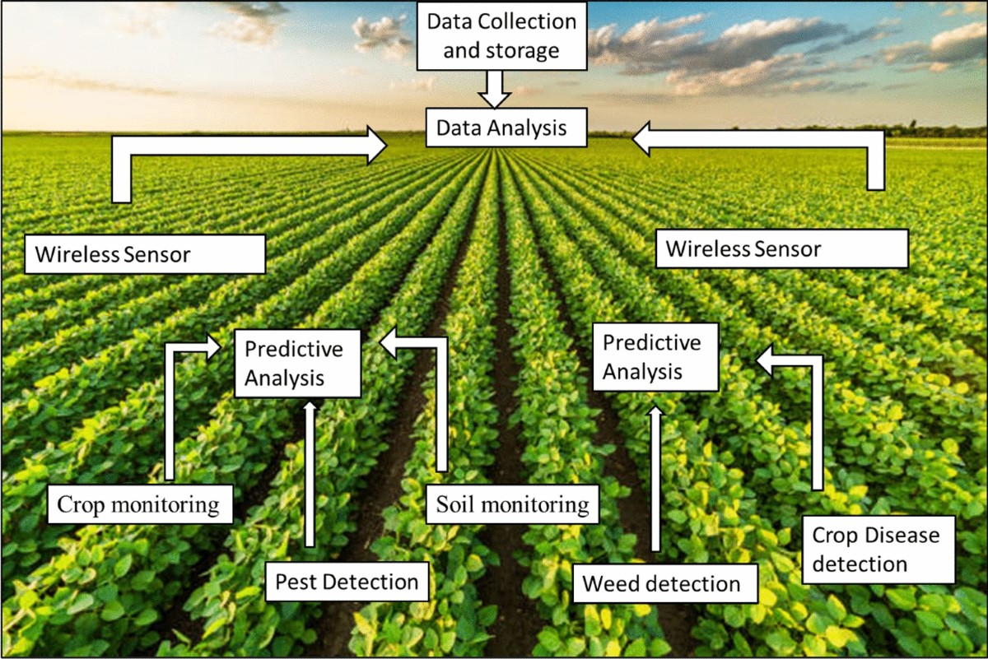
Agronomic decisions and AI
The agricultural problem determines the required data.
Models identify patterns in measurements and images.
Outputs include classifications, predictions and alerts.
Farm managers select actions and check their effects.
AITrain
04
Notes:
Explain agronomic decisions and ai. The agricultural problem determines the required data. Models identify patterns in measurements and images. Outputs include classifications, predictions and alerts. Farm managers select actions and check their effects. Ask learners to connect the information with a concrete decision in their field of study.

Slide 5
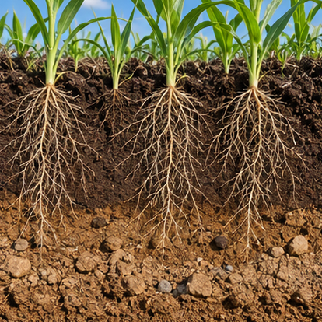
Soil as a production resource
Texture influences water retention and drainage.
Structure affects aeration, infiltration and root growth.
Organic matter supports physical and biological functions.
Soil assessment helps explain differences within a field.
AI-generated illustration
AITrain
05
Notes:
Explain soil as a production resource. Texture influences water retention and drainage. Structure affects aeration, infiltration and root growth. Organic matter supports physical and biological functions. Soil assessment helps explain differences within a field. Ask learners to connect the information with a concrete decision in their field of study.
Image: AI-generated illustrative scene. It represents the subject conceptually and does not document a specific farm, animal, product or measured result.

Slide 6
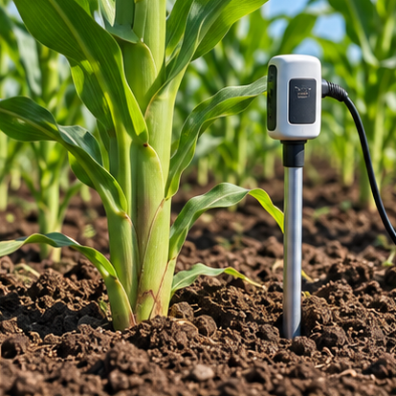
Soil monitoring and spatial variability
Sampling links laboratory results to field locations.
Moisture sensors measure conditions at selected depths.
Maps reveal zones that may need different management.
A measurement represents its sampling location and scale.
AI-generated illustration
AITrain
06
Notes:
Explain soil monitoring and spatial variability. Sampling links laboratory results to field locations. Moisture sensors measure conditions at selected depths. Maps reveal zones that may need different management. A measurement represents its sampling location and scale. Ask learners to connect the information with a concrete decision in their field of study.
Image: AI-generated illustrative scene. It represents the subject conceptually and does not document a specific farm, animal, product or measured result.

Slide 7
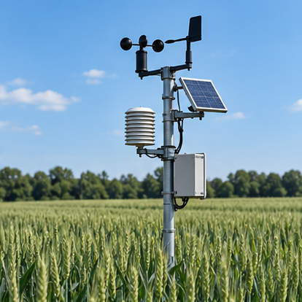
Weather and crop development
Temperature influences germination and growth.
Rainfall and evaporative demand affect water supply.
Humidity and leaf wetness can influence disease risk.
Weather information supports the timing of operations.
AI-generated illustration
AITrain
07
Notes:
Explain weather and crop development. Temperature influences germination and growth. Rainfall and evaporative demand affect water supply. Humidity and leaf wetness can influence disease risk. Weather information supports the timing of operations. Ask learners to connect the information with a concrete decision in their field of study.
Image: AI-generated illustrative scene. It represents the subject conceptually and does not document a specific farm, animal, product or measured result.

Slide 8
Weather risks and field decisions
Drought can restrict growth and nutrient uptake.
Heat stress can affect flowering and crop development.
Excess water can limit oxygen around roots.
Forecasts support inspection, scheduling and contingency plans.
AITrain
08
Notes:
Explain weather risks and field decisions. Drought can restrict growth and nutrient uptake. Heat stress can affect flowering and crop development. Excess water can limit oxygen around roots. Forecasts support inspection, scheduling and contingency plans. Ask learners to connect the information with a concrete decision in their field of study.

Slide 9
Crop groups and their requirements
Cereals, oilseeds and legumes have different production roles.
Root and tuber crops require suitable rooting conditions.
Crop choice must reflect soil, water and local climate.
Market requirements also influence variety and harvest choices.
AITrain
09
Notes:
Explain crop groups and their requirements. Cereals, oilseeds and legumes have different production roles. Root and tuber crops require suitable rooting conditions. Crop choice must reflect soil, water and local climate. Market requirements also influence variety and harvest choices. Ask learners to connect the information with a concrete decision in their field of study.

Slide 10
Cropping systems
Rotation changes the crop sequence across seasons.
Intercropping grows different crops together.
Double cropping uses successive crops within one year.
System design affects resource demand and crop protection.
AITrain
10
Notes:
Explain cropping systems. Rotation changes the crop sequence across seasons. Intercropping grows different crops together. Double cropping uses successive crops within one year. System design affects resource demand and crop protection. Ask learners to connect the information with a concrete decision in their field of study.

Slide 11
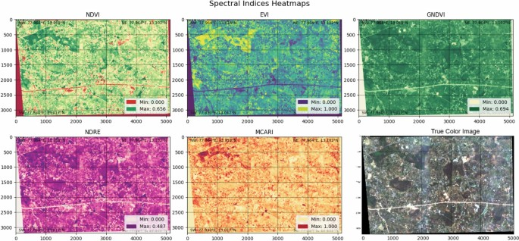
AI for crop identification
Satellite time series capture changing crop signatures.
Classification models associate patterns with crop types.
Training examples need reliable crop labels.
Field checks help confirm ambiguous classifications.
AITrain
11
Notes:
Explain ai for crop identification. Satellite time series capture changing crop signatures. Classification models associate patterns with crop types. Training examples need reliable crop labels. Field checks help confirm ambiguous classifications. Ask learners to connect the information with a concrete decision in their field of study.

Slide 12
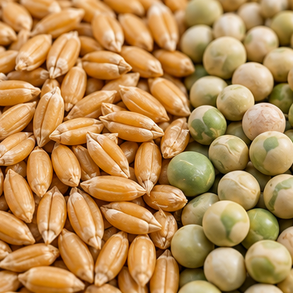
Seed quality and establishment
Germination indicates the ability to produce seedlings.
Vigour influences establishment under variable conditions.
Mechanical damage and disease can reduce seed performance.
Seed selection links quality with intended field conditions.
AI-generated illustration
AITrain
12
Notes:
Explain seed quality and establishment. Germination indicates the ability to produce seedlings. Vigour influences establishment under variable conditions. Mechanical damage and disease can reduce seed performance. Seed selection links quality with intended field conditions. Ask learners to connect the information with a concrete decision in their field of study.
Image: AI-generated illustrative scene. It represents the subject conceptually and does not document a specific farm, animal, product or measured result.

Slide 13
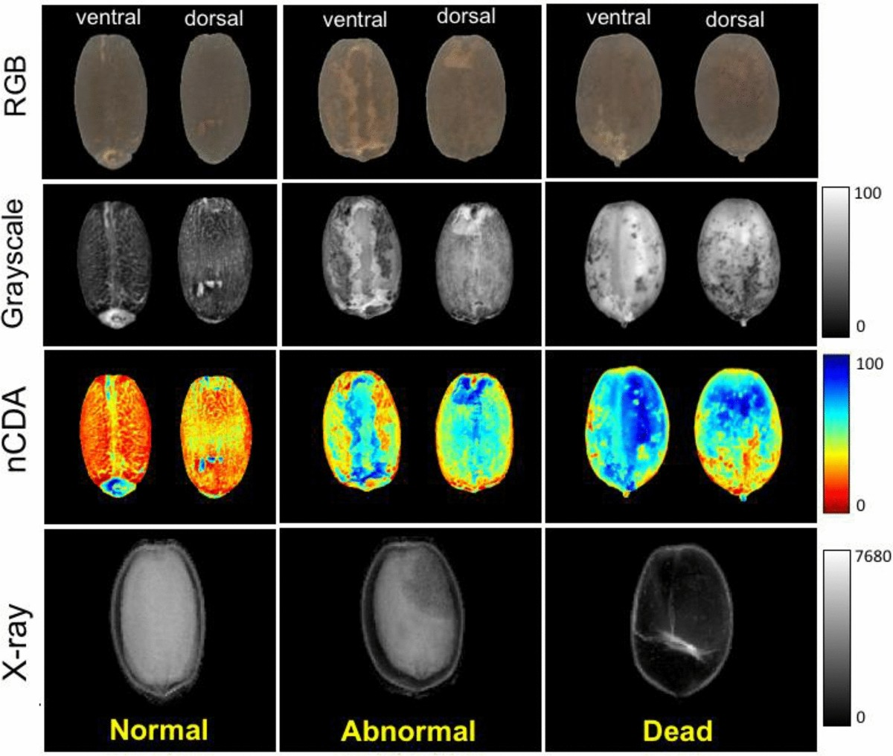
Imaging for seed assessment
RGB images describe visible size, shape and colour.
Spectral measurements reveal differences beyond appearance.
X-ray imaging can reveal internal structures.
Models need comparison with established quality tests.
AITrain
13
Notes:
Explain imaging for seed assessment. RGB images describe visible size, shape and colour. Spectral measurements reveal differences beyond appearance. X-ray imaging can reveal internal structures. Models need comparison with established quality tests. Ask learners to connect the information with a concrete decision in their field of study.

Slide 14
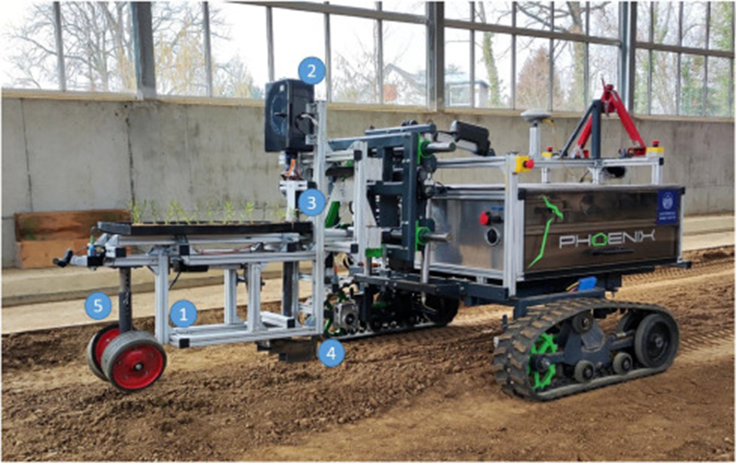
Variety choice and planting methods
Variety choice should reflect climate and production goals.
Planting depth affects emergence and seedling development.
Spacing and seed placement influence crop establishment.
Equipment settings require checks under field conditions.
AITrain
14
Notes:
Explain variety choice and planting methods. Variety choice should reflect climate and production goals. Planting depth affects emergence and seedling development. Spacing and seed placement influence crop establishment. Equipment settings require checks under field conditions. Ask learners to connect the information with a concrete decision in their field of study.

Slide 15
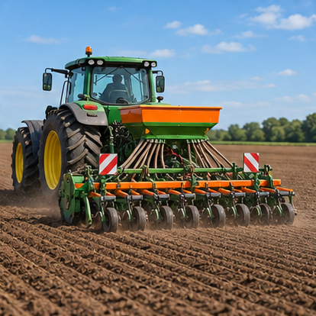
Precision planting
Navigation supports repeatable machine positioning.
Sensors monitor seed delivery and planting-unit performance.
Control systems adjust selected machine settings.
Emergence checks reveal the result of the planting operation.
AI-generated illustration
AITrain
15
Notes:
Explain precision planting. Navigation supports repeatable machine positioning. Sensors monitor seed delivery and planting-unit performance. Control systems adjust selected machine settings. Emergence checks reveal the result of the planting operation. Ask learners to connect the information with a concrete decision in their field of study.
Image: AI-generated illustrative scene. It represents the subject conceptually and does not document a specific farm, animal, product or measured result.

Slide 16
Crop nutrition and fertilization
Crop demand changes with growth stage and yield target.
Soil supply and previous management affect nutrient availability.
Deficiency symptoms can overlap with other stress symptoms.
A recommendation needs crop, soil and management context.
AITrain
16
Notes:
Explain crop nutrition and fertilization. Crop demand changes with growth stage and yield target. Soil supply and previous management affect nutrient availability. Deficiency symptoms can overlap with other stress symptoms. A recommendation needs crop, soil and management context. Ask learners to connect the information with a concrete decision in their field of study.

Slide 17
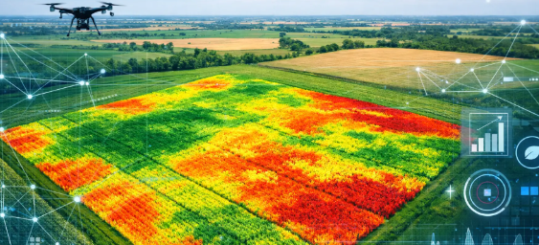
Sensing crop nutrient status
Laboratory analysis provides reference measurements.
Spectral data describe canopy differences.
AI can estimate indicators linked to nutrient status.
Water stress and crop development can affect the same signals.
AITrain
17
Notes:
Explain sensing crop nutrient status. Laboratory analysis provides reference measurements. Spectral data describe canopy differences. AI can estimate indicators linked to nutrient status. Water stress and crop development can affect the same signals. Ask learners to connect the information with a concrete decision in their field of study.

Slide 18
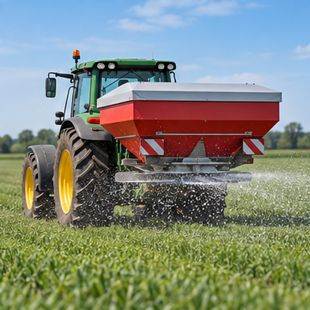
Variable-rate nutrient application
A prescription assigns different rates to field zones.
Position information links a rate to its location.
The applicator must deliver the intended material flow.
Operation records support checks of the applied treatment.
AI-generated illustration
AITrain
18
Notes:
Explain variable-rate nutrient application. A prescription assigns different rates to field zones. Position information links a rate to its location. The applicator must deliver the intended material flow. Operation records support checks of the applied treatment. Ask learners to connect the information with a concrete decision in their field of study.
Image: AI-generated illustrative scene. It represents the subject conceptually and does not document a specific farm, animal, product or measured result.

Slide 19
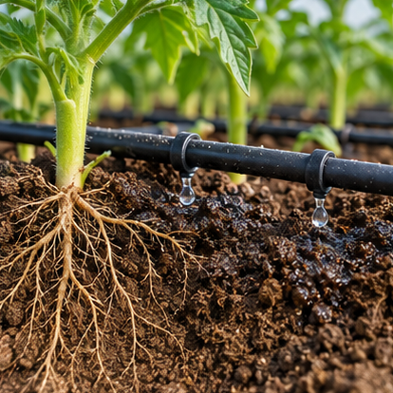
Irrigation and root-zone water
Water availability depends on soil and rooting depth.
Too little water restricts crop growth.
Too much water can reduce aeration and increase losses.
Monitoring supports irrigation decisions at relevant depths.
AI-generated illustration
AITrain
19
Notes:
Explain irrigation and root-zone water. Water availability depends on soil and rooting depth. Too little water restricts crop growth. Too much water can reduce aeration and increase losses. Monitoring supports irrigation decisions at relevant depths. Ask learners to connect the information with a concrete decision in their field of study.
Image: AI-generated illustrative scene. It represents the subject conceptually and does not document a specific farm, animal, product or measured result.

Slide 20
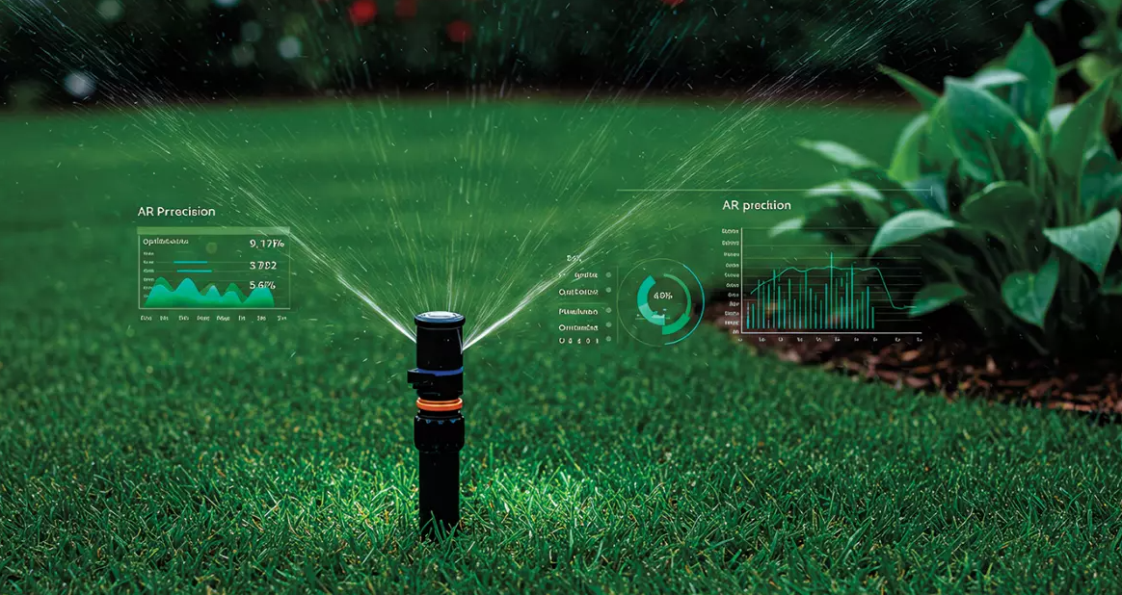
AI-assisted irrigation scheduling
Inputs can combine soil moisture, weather and crop stage.
Models estimate water demand or future soil conditions.
A controller can schedule an irrigation event.
Flow and soil-response measurements verify delivery.
AITrain
20
Notes:
Explain ai-assisted irrigation scheduling. Inputs can combine soil moisture, weather and crop stage. Models estimate water demand or future soil conditions. A controller can schedule an irrigation event. Flow and soil-response measurements verify delivery. Ask learners to connect the information with a concrete decision in their field of study.
Image credit: SoilDrops smart irrigation illustration. https://www.latimes.com/b2b/ai-technology/story/2025-07-20/soildrops-smart-ai-irrigation-for-water-conservation

Slide 21
Water quality and irrigation performance
Water composition can affect soil and crop response.
System condition influences distribution uniformity.
Blocked emitters and leaks change the delivered water.
Scheduling and installation performance require separate checks.
AITrain
21
Notes:
Explain water quality and irrigation performance. Water composition can affect soil and crop response. System condition influences distribution uniformity. Blocked emitters and leaks change the delivered water. Scheduling and installation performance require separate checks. Ask learners to connect the information with a concrete decision in their field of study.

Slide 22
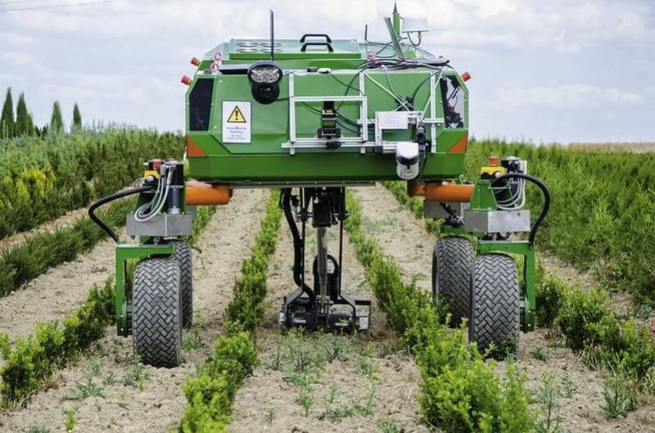
Weed recognition and targeted control
Cameras capture crop and weed features.
Models classify plants or locate treatment targets.
A controller activates the selected nozzle or tool.
Crop overlap and field conditions can reduce detection reliability.
AITrain
22
Notes:
Explain weed recognition and targeted control. Cameras capture crop and weed features. Models classify plants or locate treatment targets. A controller activates the selected nozzle or tool. Crop overlap and field conditions can reduce detection reliability. Ask learners to connect the information with a concrete decision in their field of study.
Image credit: Weed-control equipment illustration. https://www.sciencedirect.com/science/article/pii/S2666154325001553

Slide 23
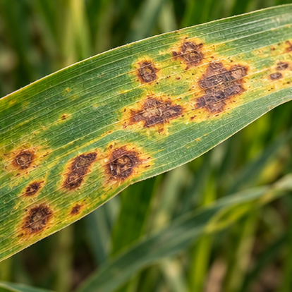
Pest and disease assessment
Symptoms provide clues that require interpretation.
Images can support recognition and prioritise inspection.
Pest monitoring needs identification and population information.
Treatment decisions should follow integrated protection principles.
AI-generated illustration
AITrain
23
Notes:
Explain pest and disease assessment. Symptoms provide clues that require interpretation. Images can support recognition and prioritise inspection. Pest monitoring needs identification and population information. Treatment decisions should follow integrated protection principles. Ask learners to connect the information with a concrete decision in their field of study.
Image: AI-generated illustrative scene. It represents the subject conceptually and does not document a specific farm, animal, product or measured result.

Slide 24
Remote sensing and field diagnosis
RGB, multispectral and thermal images measure different features.
Spatial patterns can reveal unusual crop development.
Several causes can produce similar canopy responses.
Ground observations help distinguish competing explanations.
AITrain
24
Notes:
Explain remote sensing and field diagnosis. RGB, multispectral and thermal images measure different features. Spatial patterns can reveal unusual crop development. Several causes can produce similar canopy responses. Ground observations help distinguish competing explanations. Ask learners to connect the information with a concrete decision in their field of study.

Slide 25
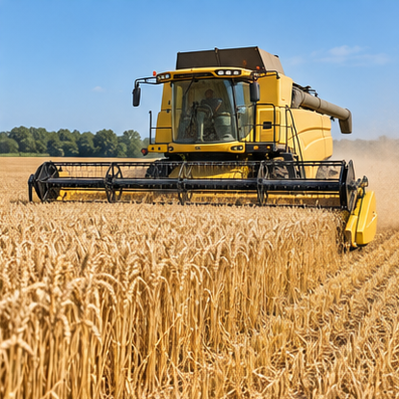
Harvest timing and machine operation
Maturity and moisture influence the harvest decision.
Machine settings affect losses and product damage.
Vision systems can support fruit detection and picking.
Harvest records connect yield with earlier field management.
AI-generated illustration
AITrain
25
Notes:
Explain harvest timing and machine operation. Maturity and moisture influence the harvest decision. Machine settings affect losses and product damage. Vision systems can support fruit detection and picking. Harvest records connect yield with earlier field management. Ask learners to connect the information with a concrete decision in their field of study.
Image: AI-generated illustrative scene. It represents the subject conceptually and does not document a specific farm, animal, product or measured result.

Slide 26
Post-harvest management
Moisture and temperature influence storage conditions.
Handling can damage products and reduce quality.
Sensors support monitoring of stored material.
AI can identify abnormal trends and prioritise inspection.
AITrain
26
Notes:
Explain post-harvest management. Moisture and temperature influence storage conditions. Handling can damage products and reduce quality. Sensors support monitoring of stored material. AI can identify abnormal trends and prioritise inspection. Ask learners to connect the information with a concrete decision in their field of study.

Slide 27
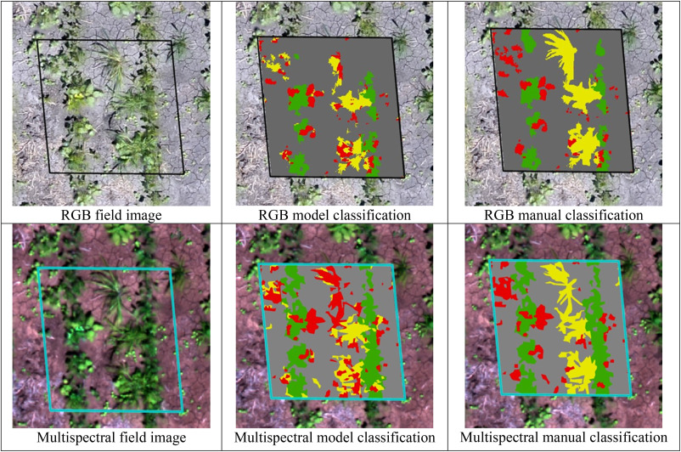
Practical activity: targeted weed control
Compare RGB and multispectral classifications.
Identify missed weeds and incorrect crop classifications.
Explain how errors could affect the treatment decision.
Prepare an inspection plan and a justified recommendation.
AITrain
27
Notes:
Teaching exercise. Ask learners to annotate the classification images, compare model and manual labels, and explain the management consequences of each type of error. Evaluate the quality of the reasoning and proposed field checks.

Slide 28
A defensible crop-management decision
Define the problem and relevant field conditions.
Use representative measurements and checked records.
Interpret the model output with agronomic knowledge.
Verify the action through field observations and operation data.
AITrain
28
Notes:
Explain a defensible crop-management decision. Define the problem and relevant field conditions. Use representative measurements and checked records. Interpret the model output with agronomic knowledge. Verify the action through field observations and operation data. Ask learners to connect the information with a concrete decision in their field of study.

